Slide 1

Student Management System
BY - VARUN BHARADWAJ SABARISH KUMAR MITALI RAGHWANI
DEEPAK KUMAR PUVVADA SANDEEP

Slide 2

Problem Statement
The problems occur when there is no digital records because of all paperwork some of them are mentioned which are : File lost / damaged, Human error, Space consuming and Cost consuming .File lost because of human environment. File damaged when a computerized system is not there ﬁle is always lost due to some accident like of water by some member on ﬁle accidentally. Besides some natural disaster like ﬂoods or ﬁres may also damage the ﬁles. Some human error there may be a loss of records. Difﬁcult to search record When there is no computerized system there is always a difﬁculty in searching of records if the records are large in number. Space consuming as it requires physical storage. As there is no computerized system to add each record paper will be needed which will increase the cost the management of library.

Slide 3

Proposed Solution
Student Management System deals with the various activities related to the students. Student Management System is software which is helpful for students as well as the school authorities.
In the Software we can register as a user and the user has two types, student and administrator. Administrator has the power to add new users
,modify and delete a user. A student can register as a user and can add, edit and delete his profile. The administrator can add, edit and delete marks for the student. All the users can see the marks.

Slide 4
Background on Project
Creating a database for organizing and storing data received through web application with student data and for fetching the most recent data from database (Clients Database). The data stored in the DB must be organized and maintained in such a way it cater to the needs of the future. Derive insights from the results to device better strategies and enhance students’ performance from the past data.

Slide 5
Features of project
The two main users involved in this system are :
User (i.e. Students)
Admin
Admin will have control over Data updates on the portal.
Registered users will have access to their proﬁle as well as they can view all the data on the website like notices also update their passwords.
Non Registered users can view welcome and contact us page only.

Slide 6


Workﬂow
Welcome Page consist of login portal where there is contact us information.
Unregistered users can view only above mentioned information.
Login is for registered user and admin .
For admin there are options in Dashboard for adding, deleting and editing student proﬁles and notices.
Modiﬁcations will be directly done in database server as it is interfaced with the frontend.
User can see their proﬁle, notices as well as can change passwords through the dashboard.

Slide 7
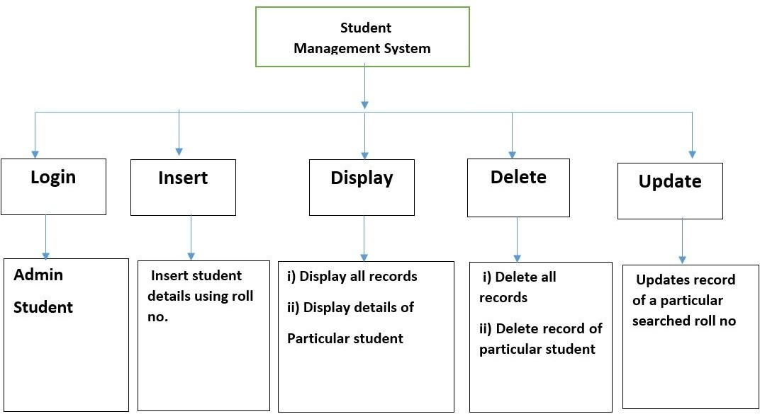
Architecture Diagram

Slide 8
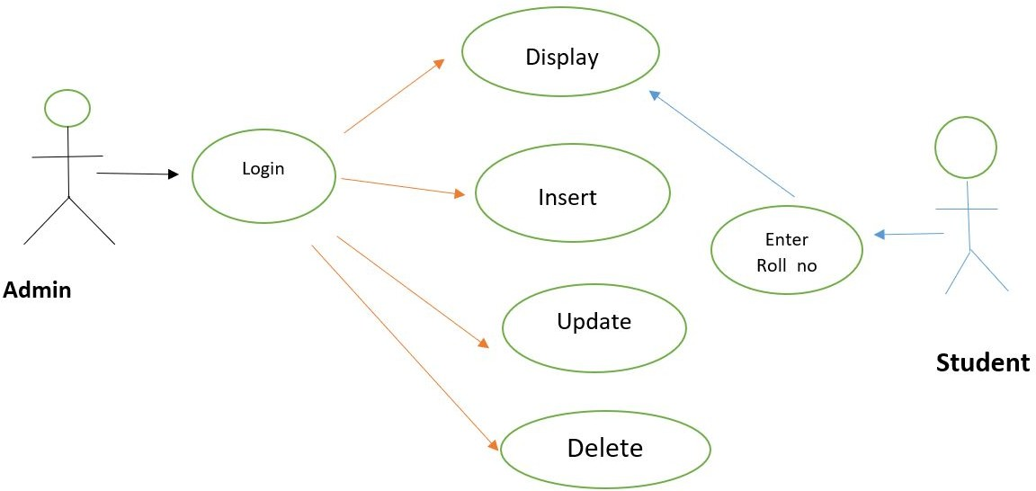
Use - Case Diagram

Slide 9
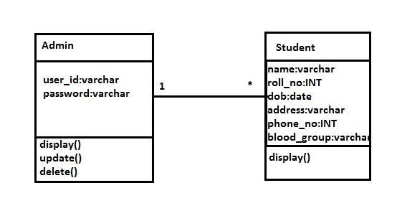
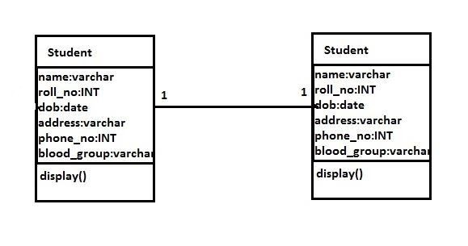

Class Diagram

Slide 10
Requirements
Hardware Requirements:
Processor: Intel P-IV System
Processor Speed: 250 MHz to 833 MHz
Ram: 512 Mb Ram
Hard Disk: 40 Gb
Software Requirements:
Windows/ Linux Based OS/ Mac OS/ Any OS capable of running c++
MySQL database
Xampp server

Slide 11

Conclusion
Student Management System can be used by educational institutions to maintain their student records easily. Achieving this objective is difficult using the manual system as the information is scattered, can be redundant, and collecting relevant information may be very time-consuming. All these problems are solved by this project.
This system helps in maintaining the information of pupils of the organization. It can be easily accessed by the manager and kept safe for a long period of time without any changes.

Slide 12
THANKYOU

